Slide 1
May 2015

Slide 2
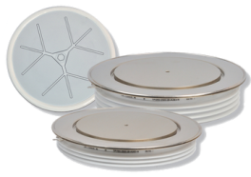
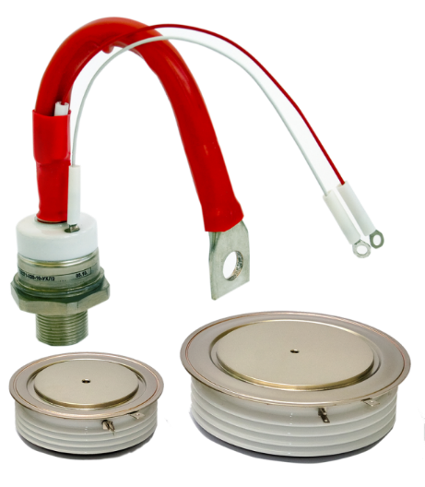
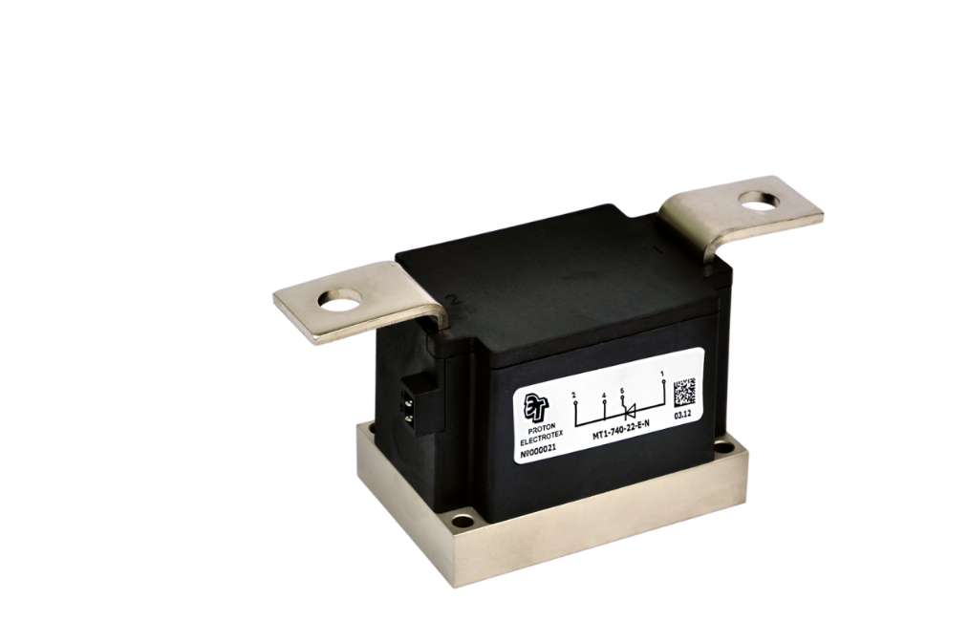
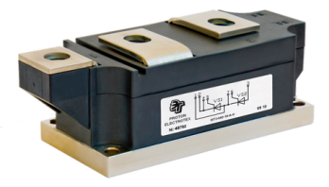
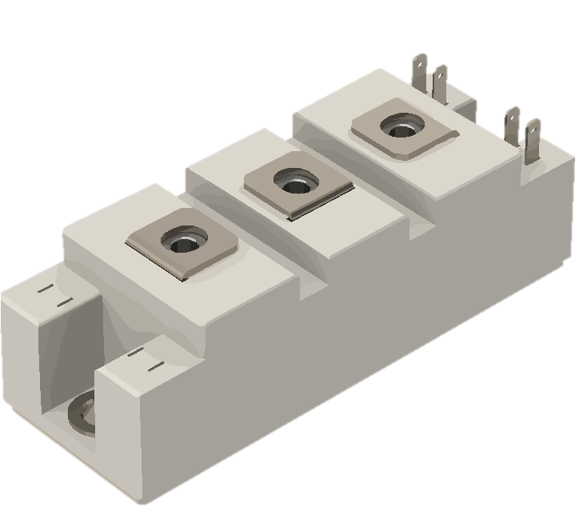
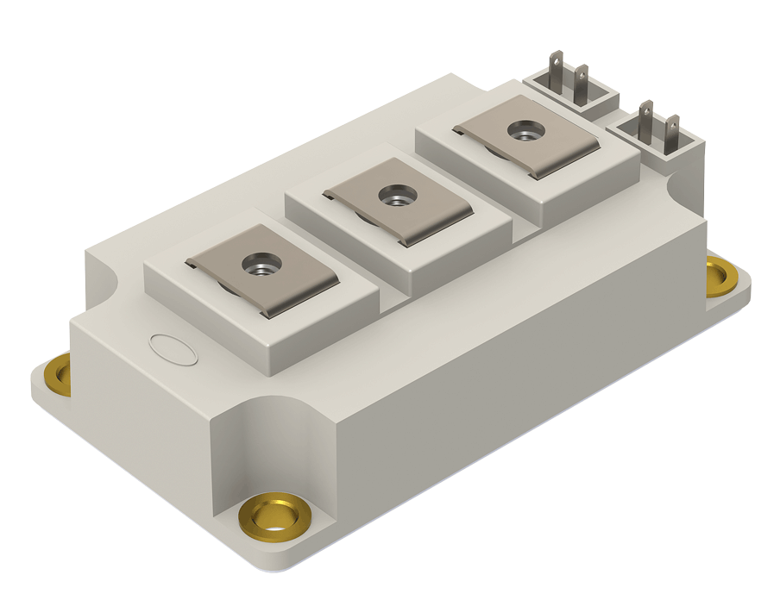
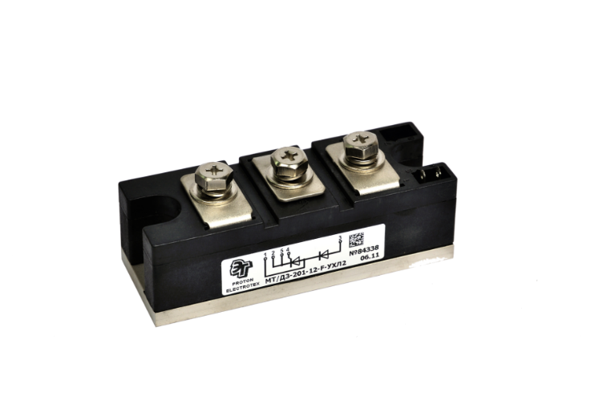
FACTS
founded in 1996 on the basis of PROTON company
(part of the Ministry of Electronic Industry since 1972)
JSC PROTON-ELECTROTEX
Development and Production of Bipolar Power Semiconductor Devices in stud, disk and module design, IGBT modules and Power stacks, Measuring Equipment
Up-to-date technology
Modern production and measuring equipment
Clean rooms
> 400 employees (35% - R&D engineers)
> 15000 m² of production facilities

Slide 3
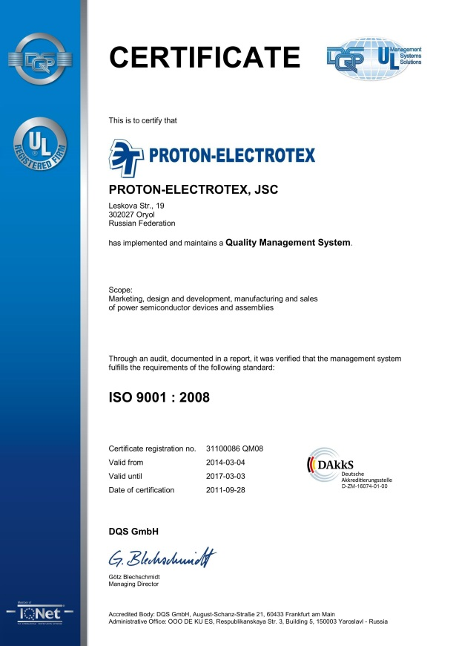
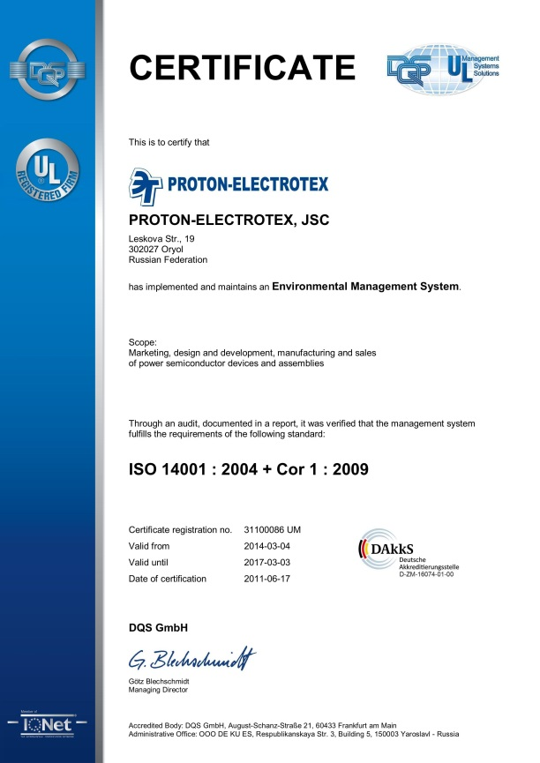
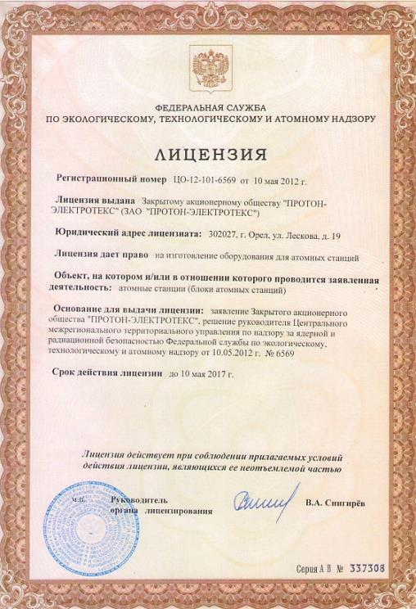
CERTIFICATION
2002 - Quality Management System of the company is certified ISO 9001
2007 - Ecological Management System of the company is certified ISO 14001
2007 - Products are licensed by the “Federal Agency on ecological, technologic, and nuclear control” for using in nuclear industry
2009 - Products are licensed by the “Russian Railways technical control”
.
.

Slide 4
AWARDS and ACHIEVEMENTS
2001 – First Russian company to participate in PCIM Europe (Power Conversion Intelligent Motion) exhibition
2005-2006 – Complex state project realized together with the Federal State Unitary Enterprise "All-Russian Electrotechnical Institute named after V.I.Lenin“ - “Development of advanced technologies and production of new energy-efficient types of electrical equipment”
2006 – “Leader of Russian Economics” award by Russian Federation State Duma
2010 – Establishment of Joint Venture Hebei Proton-Electrotex Electronic Co., Ltd. In China
2010 – R&D Center established in Moscow having the best engineers of "All-Russian Electrotechnical Institute named after V.I.Lenin“ working there
2014 – Successful completion of international project in Japan in cooperation with Nichicon company, Osaka University (Center for Advanced High Magnetic Field Science), Mishima Denshi company, and Eich Corporation company (official distributor of Proton- Electrotex products in Japan) – Development and production of pulse magnetic field generator with stored energy 10 MJ 2015 – 15 year anniversary of continuous participation in PCIM Europe exhibition
.
.

Slide 5
STRENGTHS
European Competition
Chinese Competition
Same high quality product at competitive prices
Short delivery time
Delivery to any location
Delivery on any Incoterms
Special design and characteristics products
Customers’ technical support
100% pin-to-pin alternative to European brands
Up-to-date technology and modern production and measuring equipment
High time-proven reliability of business
Trusted allied Sino-Russian relations

Slide 6
CHINESE PARTNERS
Beijing Fushijia Electronic Equipment Co., Ltd.
(Block A,room 801,Haidian culture and art building, #28-1 of Zhongguancun road, Haidian district, Beijing, China)
Cooperation started in 2013
Distribution of power semiconductors on Chinese market
Technical support of local customers
Hebei Proton-Electrotex Electronic Co., Ltd.
(053500 west of Jiadao Road, Open Economic East Zone,
Jing Country, Hebei Province, China)
Joint Venture established in 2009
Distribution of power semiconductors on Chinese market
Technical support of local customers

Slide 7
Thanks for Your attention
www.proton-electrotex.com

